Slide 1

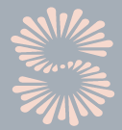
DRY SKIN
DR NEZ SPENGANE
DERMATOLOGIST
Christiaan Barnard Memorial Hospital
Cape Town

Slide 2
DISCLAIMER
Eucerin is the sponsor of this talk to advance the scientific and educational knowledge for Healthcare Professionals. Eucerin does not endorse this presentation, nor does it warrant that any of the information provided by the presenter, is accurate, complete, free of error or that it contains any omissions. Eucerin shall not be liable for any loss to any party, whatsoever, arising from the use of any of the information relayed in this presentation

Slide 3
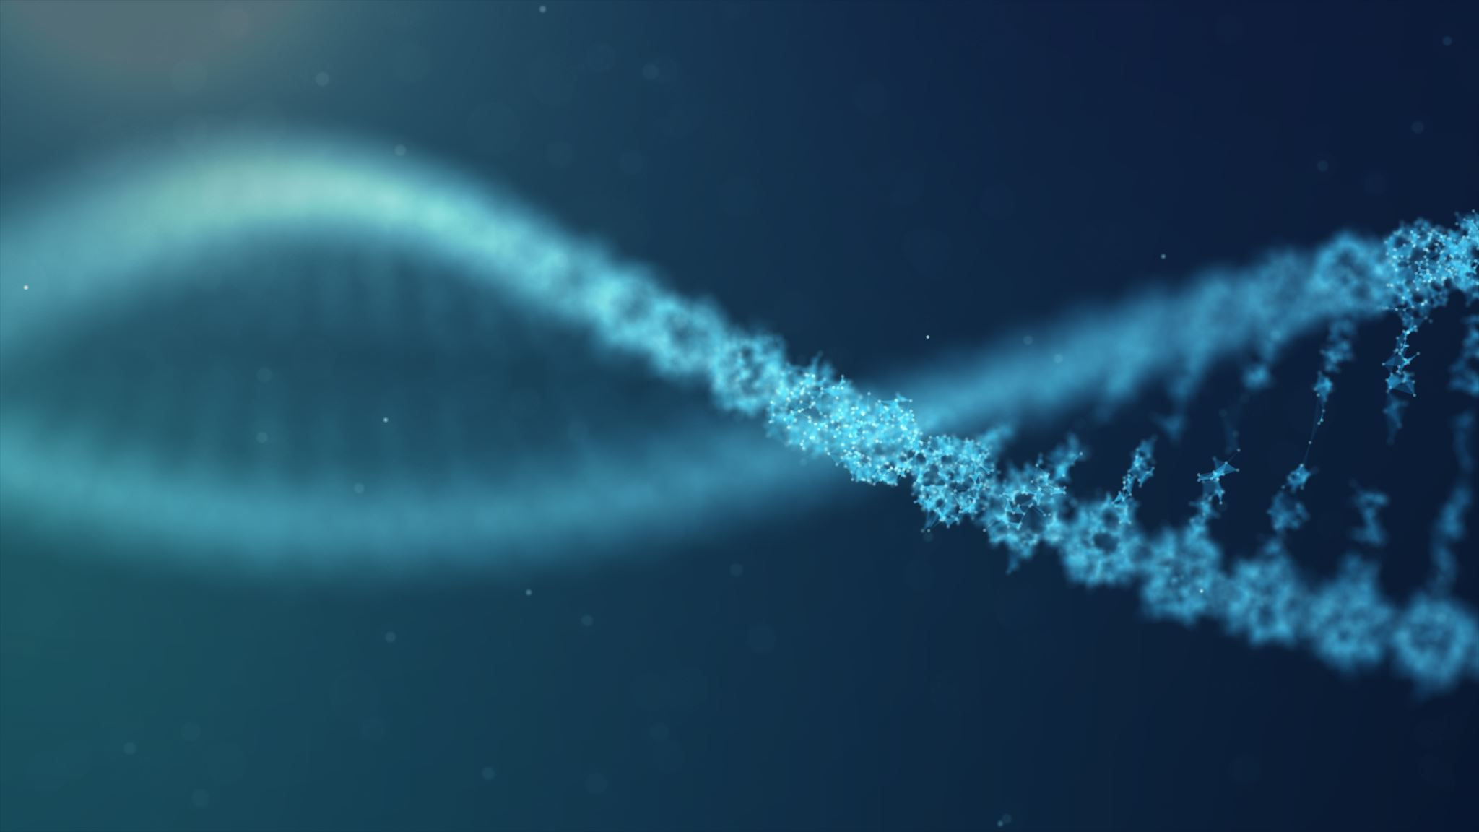
STRUCTURE AND FUNCTION OF NORMAL SKIN

Slide 4
SKIN
The skin, the biggest organ in the body has many roles:
Provides a barrier to maintaining the steady state of the cellular environment inside the body
Protects against physical and chemical stimuli from the external environment.
Protects against foreign materials, microbes, and irradiation.
The skin is an immune organ, providing the distal defence against foreign antigens, and is an endocrine organ, serving as the site of the initial synthesis of vitamin D.

Slide 5
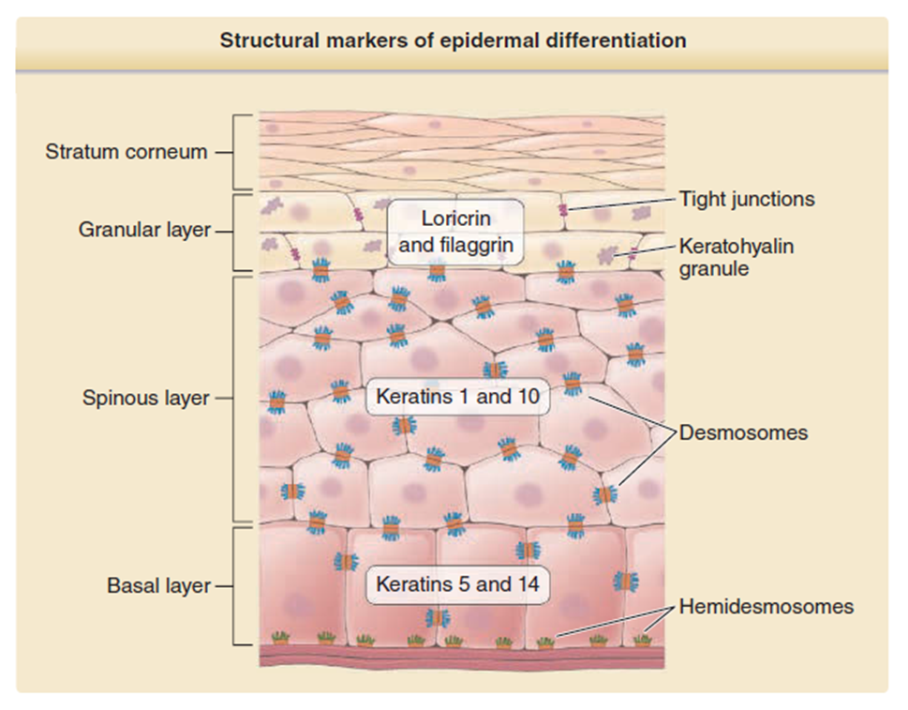
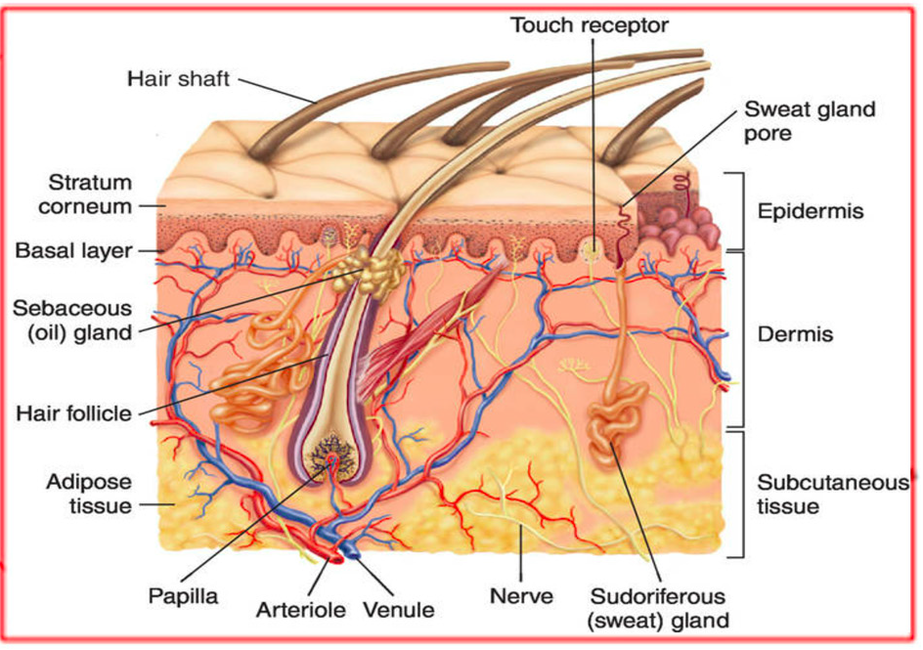

Slide 6
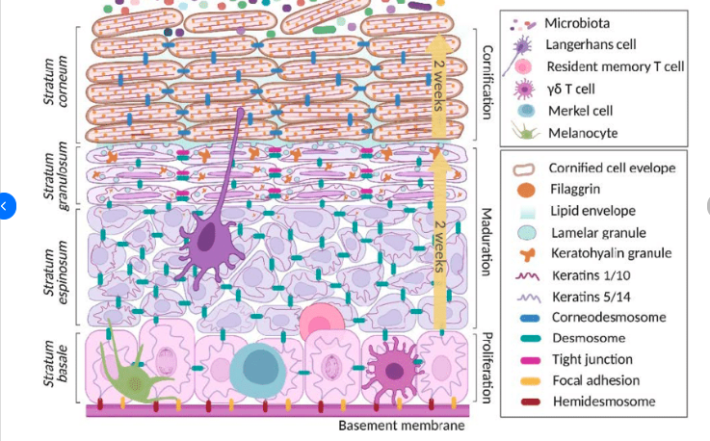
Spinous layer - There is an upregulation of desmosomes (cell-cell adhesions) between keratinocytes, this gives them a spiny appearance in histologic sections. Adhesions keep skin cells firmly attached to each other.
Basal layer - provides "stem cells" necessary for the regeneration of the layers of the epidermis. The cells in this layer are mitotically active, which is necessary for normal epidermal turnover and wound healing.
Pamela Gallegos-Alcalá . 2021. The Keratinocyte as a Crucial Cell in the Predisposition, Onset, Progression, Therapy and Study of the Atopic Dermatitis. Int. J. Mol. Sci. 2021, 22, 10661. https://doi.org/10.3390/ijms221910661

Slide 7
Granular layer – contains granules composed of keratins, profilaggrin, filaggrin and loricrin, and other proteins that make up (stratum corneum).
Profilaggrin is metabolized into amino acids and urocanic acid (natural moisturizing factor [NMF] to provide hydration and UV protection
Filaggrin is an essential protein in the formation of the stratum corneum. Mutations in the FLG gene are responsible for ichthyosis vulgaris and are associated with a higher risk of developing atopic dermatitis.
Ceramide synthesis occurs in the upper spinous and granular cell layers
Pamela Gallegos-Alcalá . 2021. The Keratinocyte as a Crucial Cell in the Predisposition, Onset, Progression, Therapy and Study of the Atopic Dermatitis. Int. J. Mol. Sci. 2021, 22, 10661. https://doi.org/10.3390/ijms221910661

Slide 8
Stratum corneum consist of “cornified envelopes” are acellular, anuclear corneocytes wrapped with lipid rich layer (envelope).
Pamela Gallegos-Alcalá . 2021. The Keratinocyte as a Crucial Cell in the Predisposition, Onset, Progression, Therapy and Study of the Atopic Dermatitis. Int. J. Mol. Sci. 2021, 22, 10661. https://doi.org/10.3390/ijms221910661

Slide 9
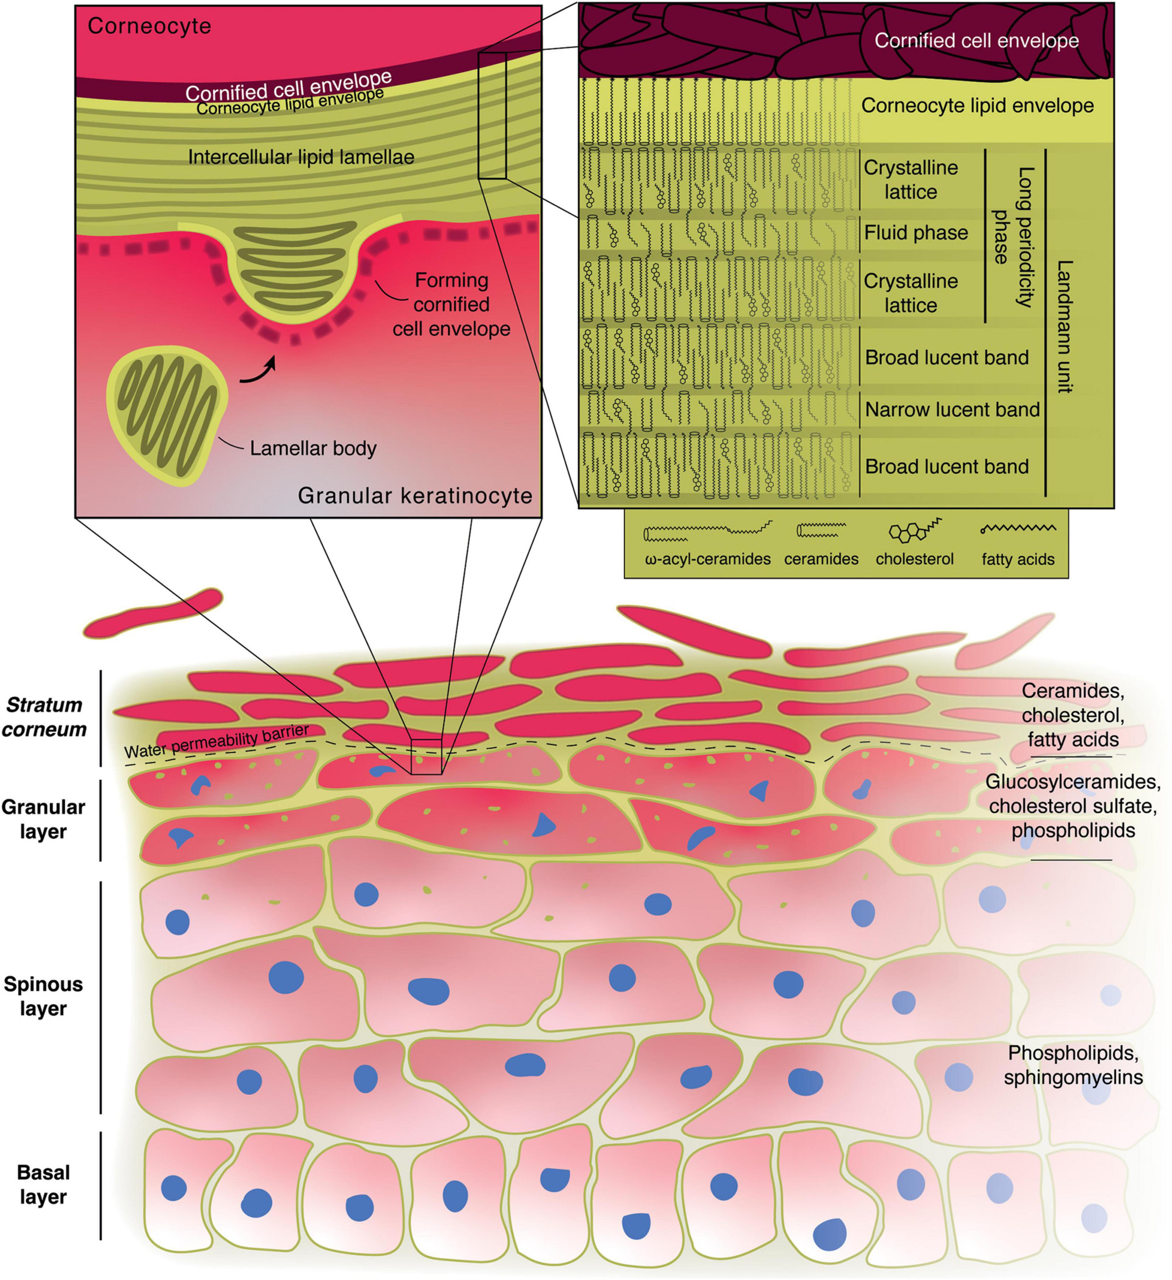
ROLE OF LIPIDS IN THE FORMATION OF THE EPIDERMAL WATER PERMEABILITY BARRIER
Ceramides - are essential for the formation of the permeability barrier.
Fatty acids, non-hydroxy, α-hydroxy or ω-hydroxy acids contribute to the formation of glucosylceramide
Linoleic acid, an essential fatty acid forms α-hydroxyl of the glucosylceramide—deficiency of linoleic acid results in dry, scaly skin.
Acylglucosylceramide is converted to acylceramide. Corneocyte outer coating by the acylceramide protects the cornified cell from attack by proteolytic enzymes secreted by microorganisms
Cholesterol, cholesterol esters contribute to the lipid envelope
The crosslinking of proteins and the presence of specialized lipids result in mechanical stability and relative impermeability of the epidermis
Notes:
Omega hydroxy acids (ω-hydroxy acids)

Slide 10
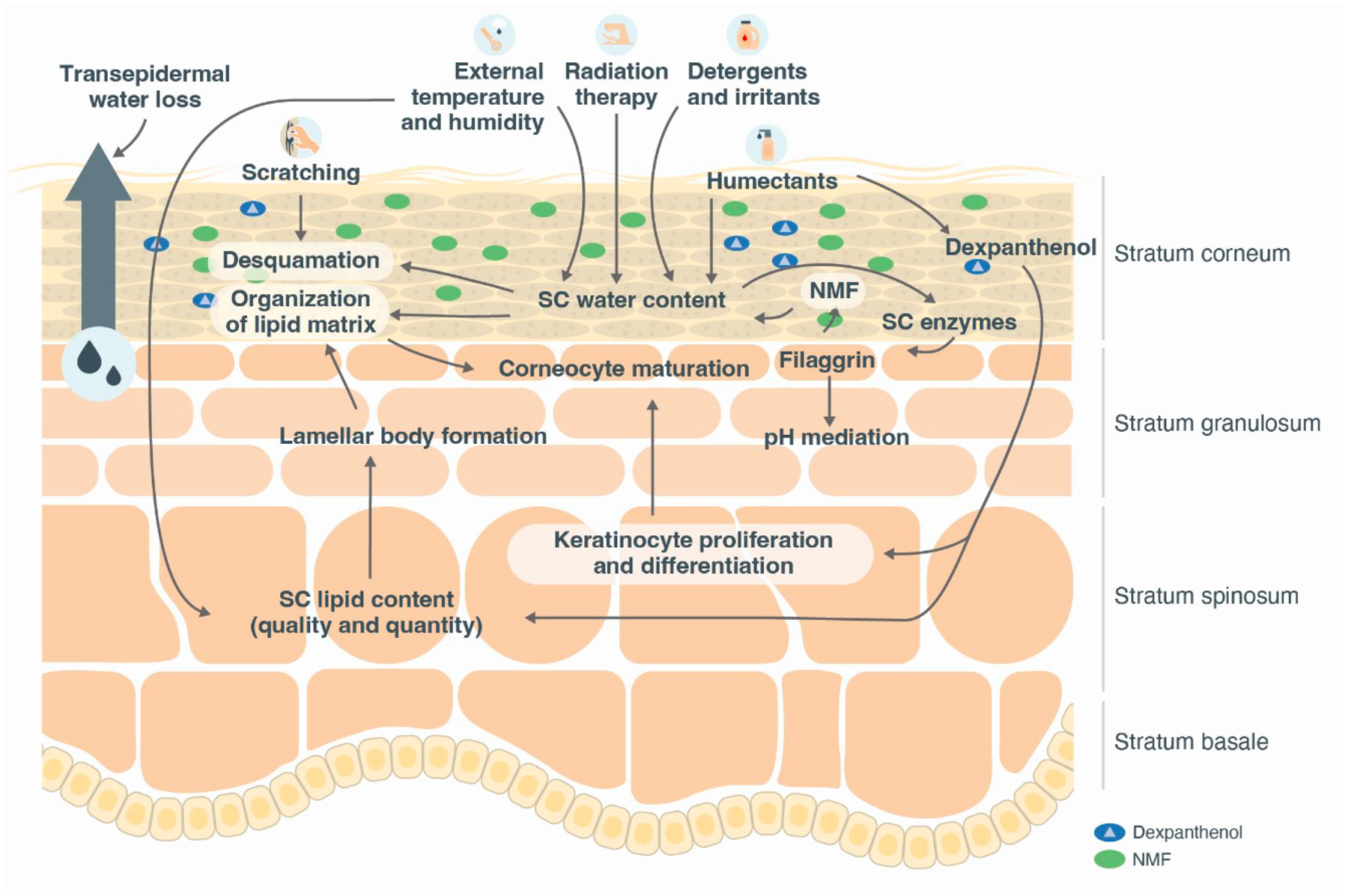
What happens when this is disrupted?
DS → damaged skin barrier, elevated pH, which encourages the penetration of irritants, allergens, and bacteria into the skin. Promoting the cyclic worsening of skin equilibrium
When the permeability barrier is impaired or disrupted, DNA synthesis increases and cytokines are released from keratinocytes, initiating an inflammatory cascade
M Augustina et al.
https://doi.org/10.1080/09546634.2024.2326171

Slide 11
Xerosis
Xerosis – is dry skin. This occurs when the skin is lacking moisture in the (stratum corneum) and this results in cracks in the skin surface. Often associated with pruritus.
Dry skin can occur in any age group or population. Everyone has had dry skin at some point in their lives. Cause is multifactorial.
Endogenous factors
Age
Menopause
Endocrine disorders: hypothyroidism, diabetes
Chronic illness: renal failure, Fe deficiency, malignancy, HIV
Malnutrition and weight loss
Cutaneous conditions: eczema, ichthyosis, psoriasis,
Medication: oral/topical retinoids, diuretics, lipid lowering drugs, chemotherapy, radiation
Exogenous factors
Low humidity in dry climates or cool, windy conditions
Excessive air conditioning
Direct heat e.g. fire or heater
Photodamage - prolonged exposure to sun
Excessive bathing, hand washing
Contact with soap, laundry detergents and solvents
Inappropriate topical agents such as alcohol, acetone
Frictional irritation from rough clothing or abrasives

Slide 12

Clinical Presentations

Slide 13
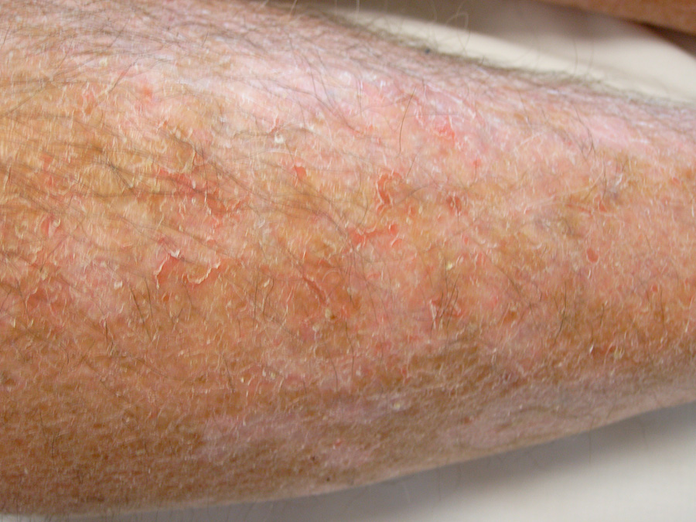
Physical examination - reveals rough, dry skin, light scaling. This may worsen inducing redness and cracking of the skin associated with pruritus.
Reduced water content
↓ production of lipids
↓ size of sweat glands
↓ size of sebaceous glands
Menopause causes changes to lipids and glycosaminoglycans in the skin worsening physiological xerosis
6. Reduced vasculature
7. ↓ thickness of the dermis thus making vasculature vulnerable increase in bruising
E. Foy White-Chu et. al 2011.

Slide 14
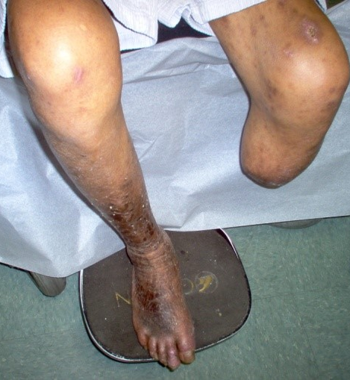
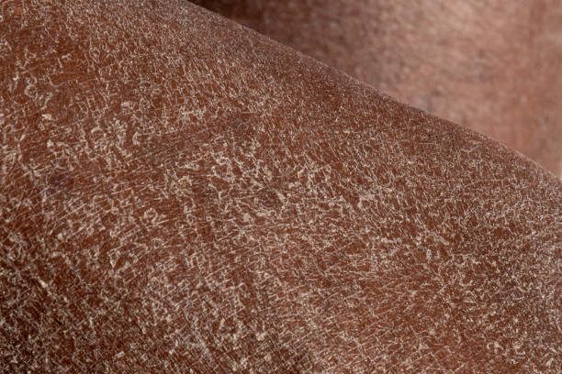
Diabetes
Hypothyroidism
Damage to vasculature
Causing decreased blood supply to the skin
Leads to decreased supply of essential amino acids, fatty acids and electrolytes and vitamins which all play a role in the reproduction of keratinocytes and their lipid layer.
The skin is dry and the stratum corneum is poorly hydrated.
The xerosis mimics acquired ichthyosis
Histologically, the epidermis is thin, and there is hyperkeratosis with follicular plugging.
The generalized distribution of these findings more prominent the arms and legs with fine wrinkling of the skin.
Ref: Prevention & early intervention for Diabetes Foot Problems. www.ndep.nih.gov/media/feet_hcguide.pdf

Slide 15
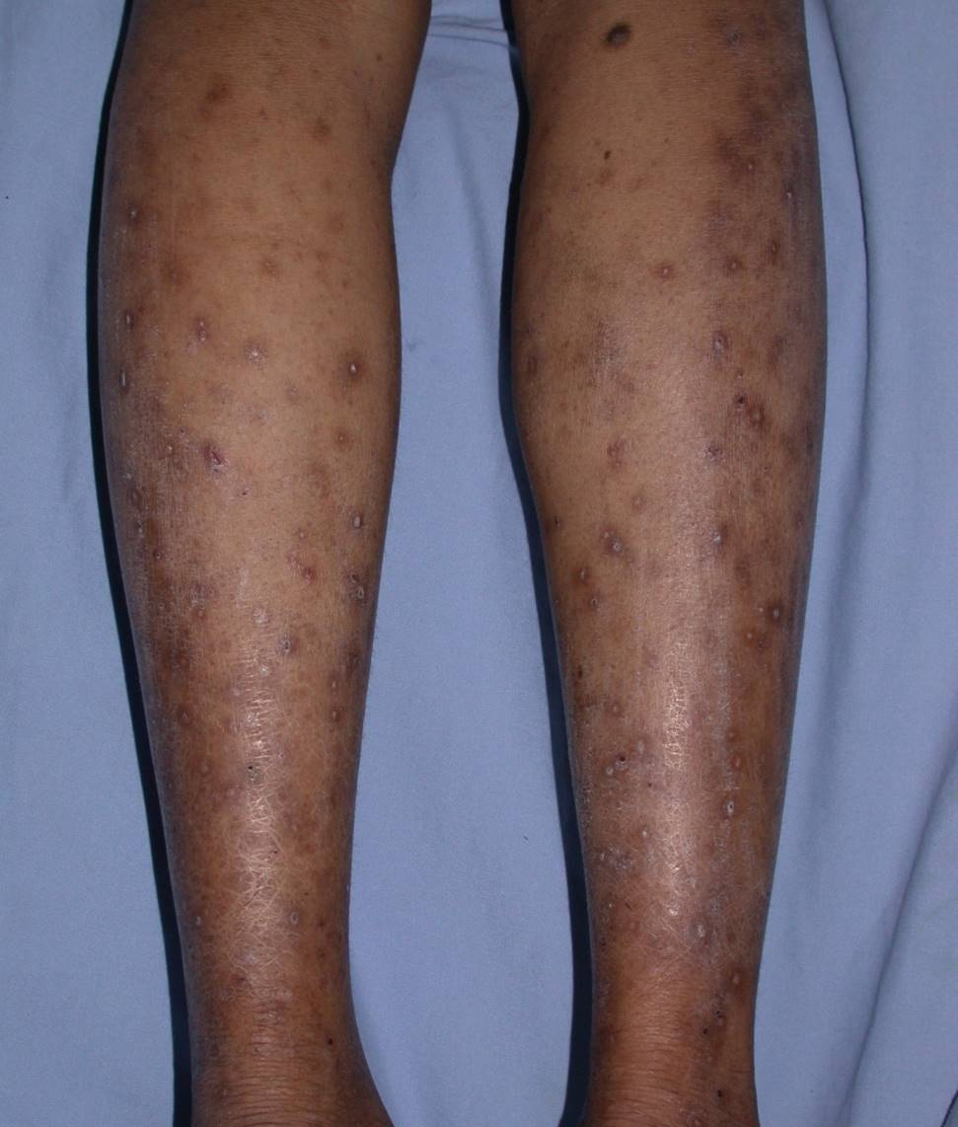
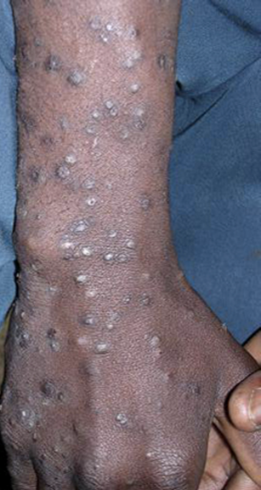
HIV: Papular pruritic eruption
(PPE) of HIV infection is characterized by severe pruritus, dry skin and skin-coloured to erythematous, non-follicular papules that are distributed symmetrically on the extremities and
Excoriations
prurigo nodularis, and post-inflammatory hyperpigmentation
PPE is a hypersensitivity reaction to arthropod (insect) antigens
TREATMENT
Start ART
Topical steroids
Antihistamines
Emollients

Slide 16
Management of Dry skin
The application of moisturizers should be an integral part of the treatment. There is strong evidence that their use can reduce severity and the need for pharmacologic intervention
Moisturizers should be applied soon after bathing to improve skin hydration
  Emollients (e.g., glycol and glyceryl stearate, soy sterols) lubricate and soften the skin
  Occlusive agents (e.g., petrolatum, dimethicone, mineral oil) form a layer to prevent TEWL
  Humectants (e.g., glycerol, lactic acid, urea) attract and hold water
Limited use of fragranced soap and rather use non-soap cleansers (that are neutral to low pH, hypoallergenic, and fragrance-free) is recommended

Slide 17
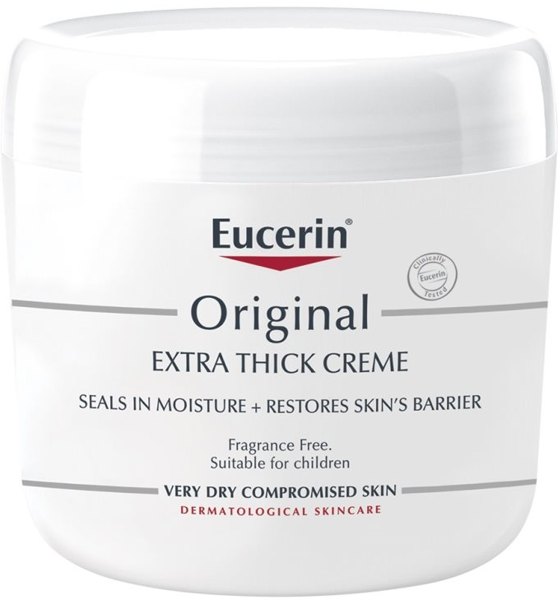
Extra thick creme
This very thick rich formula is a water-in-oil emulsion with simple, trusted ingredients, and no irritating fragrances or dyes, to soothe and help restore even severely dry skin.
Petrolatum – occlusive agent, prevents TEWL
Mineral Oil – prevents TEWL
Lanolin Alcohol – a derivative of lanolin, lanolin possesses anti-inflammatory, anti-microbial, wound healing in a moist environment, and skin protective properties
The rate of contact allergy to lanolin in the general population has been estimated to be lower (<0.5%).

Slide 18
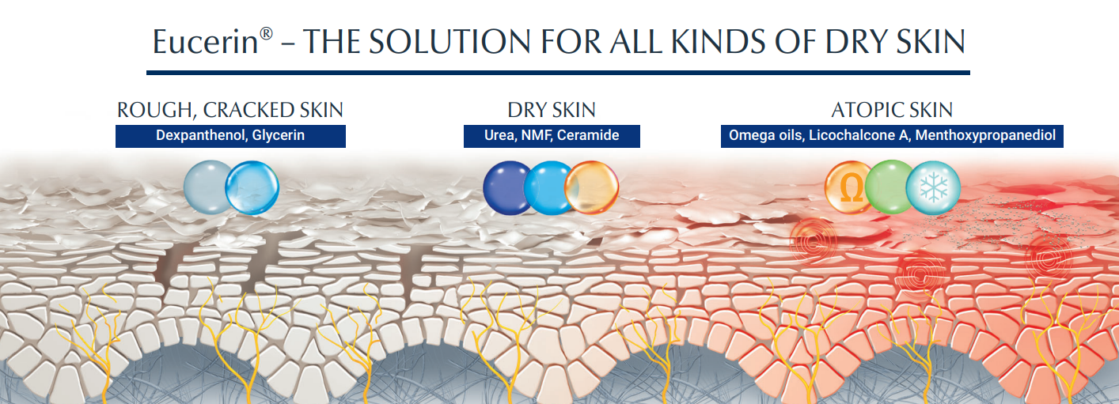
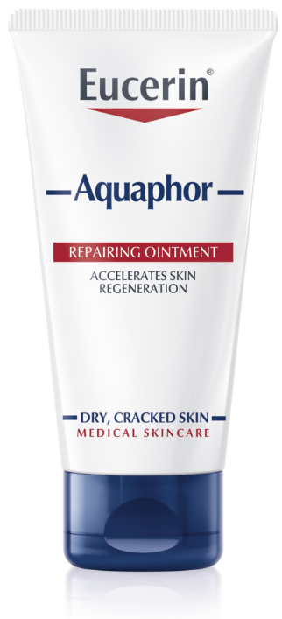
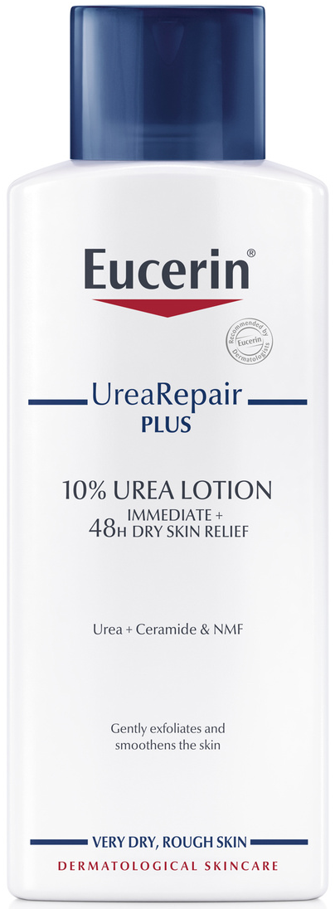
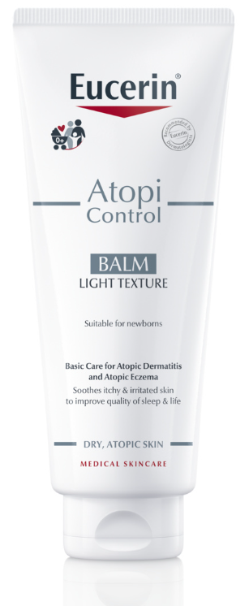
ACTIVE REPAIR
ACTIVE MOISTURISATION
ACTIVE SOOTHING

Slide 19
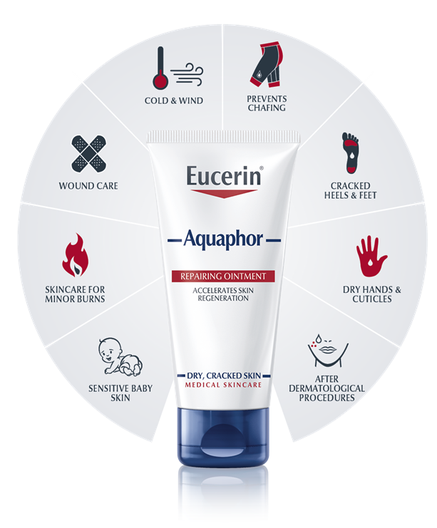
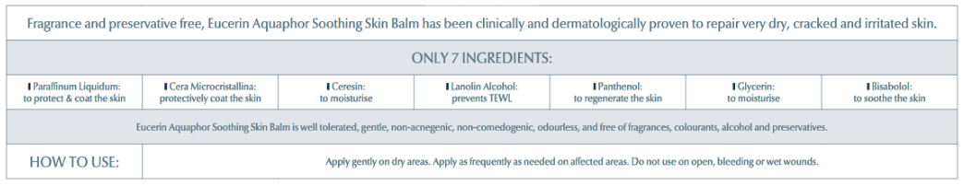

Dry, Cracked Irritated Skin
Aquaphor
Glycerin – is a humectant which attracts and traps water in the skin. It is a very effective moisturizer that smooths dry skin and gives it long-lasting moisturization
Dexpanthenol maintains and moisturizes the skin barrier, reduces TEWL
Antipruritic properties
Increases elasticity in the SC
Preserves and improves skin-barrier function
Paraffinum Liquidum and Cera Microcristallina form a semi-permeable, protective coat over the skin which maintains the natural rate of water vapour loss due to evaporation
Notes:
Eucerin Aquaphor is clinically proven to repair dry, cracked and irritated skin and accelerate skin regeneration. When the skin is protected, it can regenerate itself more efficiently. Eucerin Aquaphor is suitable for use on babies and ideal for targeted body and face areas:
Aquaphor is a true multitasker.
Go through the different topics step by step.

Slide 20
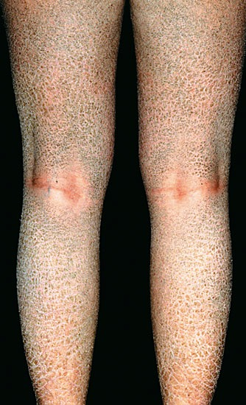
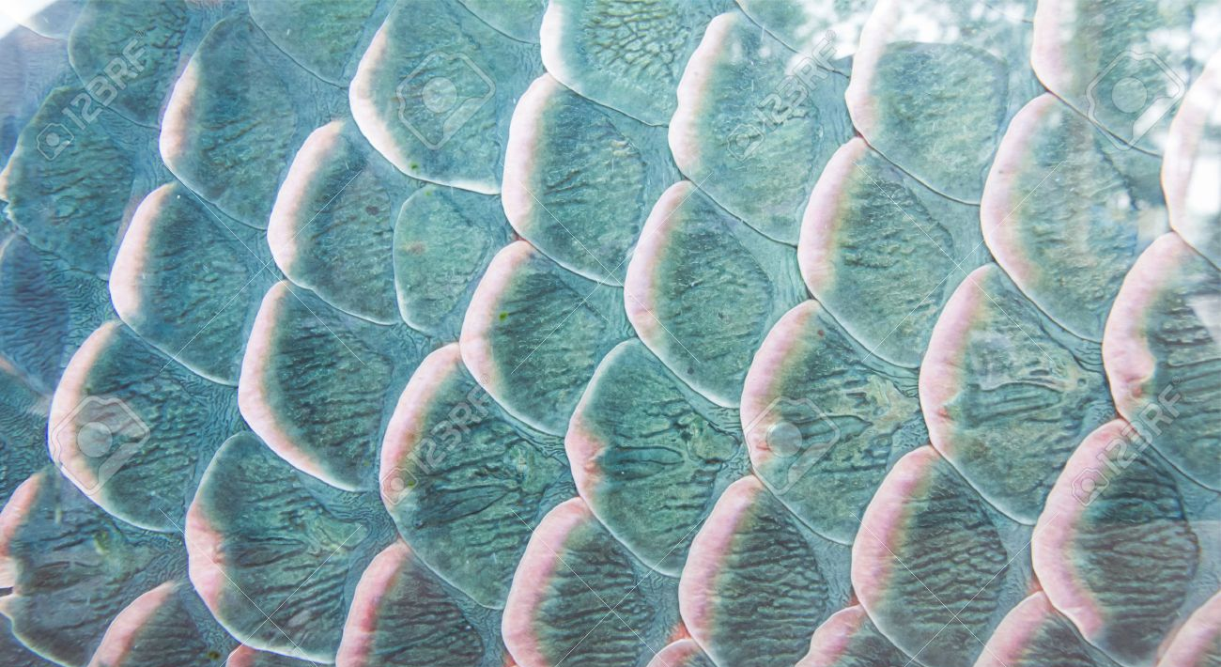
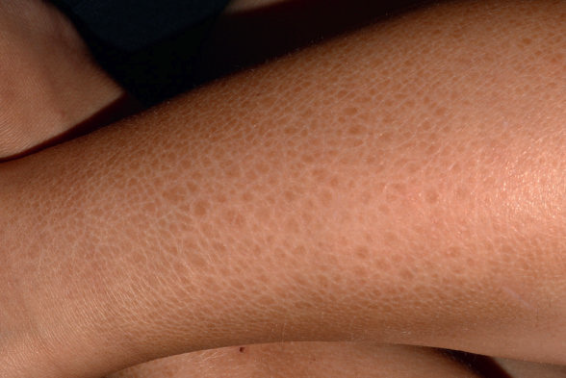
Ichthyosis vulgaris
From Greek word ichthy = fish like
Common genetic form of ichthyosis
Associated with atopic dermatitis, asthma, and/or allergic rhinitis
Filaggrin is an essential protein in the stratum corneum. Mutations in the FLG gene are responsible for ichthyosis vulgaris and are associated with a higher risk of developing atopic dermatitis
Treatment
Hydration - Urea-containing creams bind water
Emollients

Slide 21
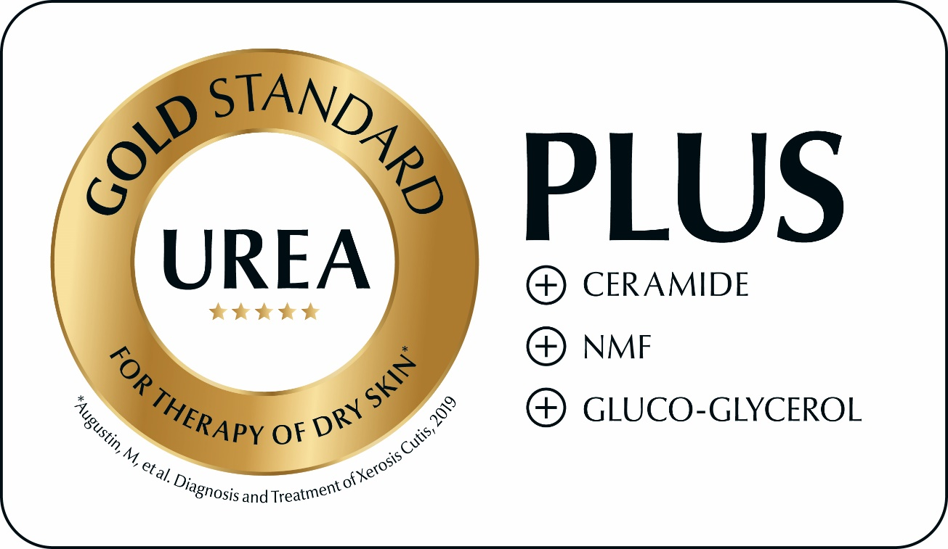
More than just urea
SKIN-RELATED REPAIR PLUS COMPLEX
Intense research shows: The combination of UREA with CERAMIDES, NMF and GLUCOGLYCEROL shows a significantly better effect than the effect of urea or the vehicle alone!
+35%
efficacy compared to
normal Urea products
Sources: TERESA M. WEBER: Treatment of Xerosis with a Topical Formulation Containing Glyceryl Glucoside, Natural Moisturizing Factors, and Ceramide, in The Journal of Clinical and Aesthetic Dermatology, August 2012
Notes:
The basic therapy for xerosis cutis should improve hydration of the skin, compensate for a deficiency in barrier lipids and improve the barrier function of the skin. A combination of hydrophilic and lipophilic components is therefore to be preferred (100% consensus).
Based on the present scientific data, urea (syn. carbamide) is the gold standard for the therapy of xerosis cutis. Urea not only effectively hydrates the skin, but it also improves the barrier function, the skin’s own immunity and hydrating mechanisms. It increases the penetration of active substances into the skin, relieves itching and – at higher concentrations – is keratolytic.
In combination with ceramides and NMF, the hydrating efficacy of urea is superior to a pure foundation or an external preparation that contains only urea.
UREA IS THE GOLD STANDARD FOR XEROSIS THERAPY

Slide 22
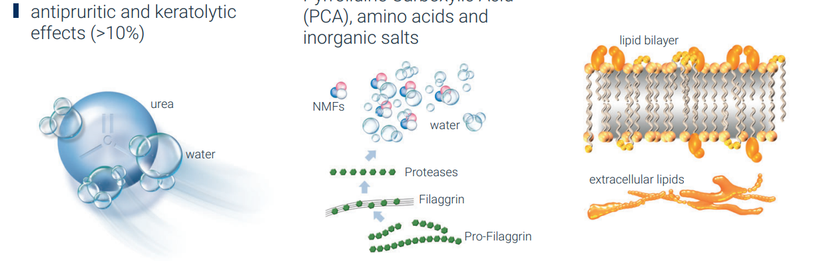
Dry, itchy and flakey Skin
UreaRepair PLUS – Most Important Ingredients
Urea (synonym: carbamide)
NMF (Natural moisturizing Factor)
Ceramides (sphingolipids)
hydrates the skin
improves barrier function
improves the skin’s defense and hydration mechanisms
Aids penetration of active ingredients into the skin
antipruritic and keratolytic effects (>10%)
Water-binding components in the epidermis that result
from the breakdown of Filaggrin in the stratum corneum or are derived from sweat
NMF includes Urea, Lactic Acid derivatives, Pyrrolidine Carboxylic Acid (PCA), amino acids and inorganic salts
Main components (~ 40%) of the extracellular lipid matrix of the stratum corneum
Lack of Ceramides: impaired barrier function

Slide 23
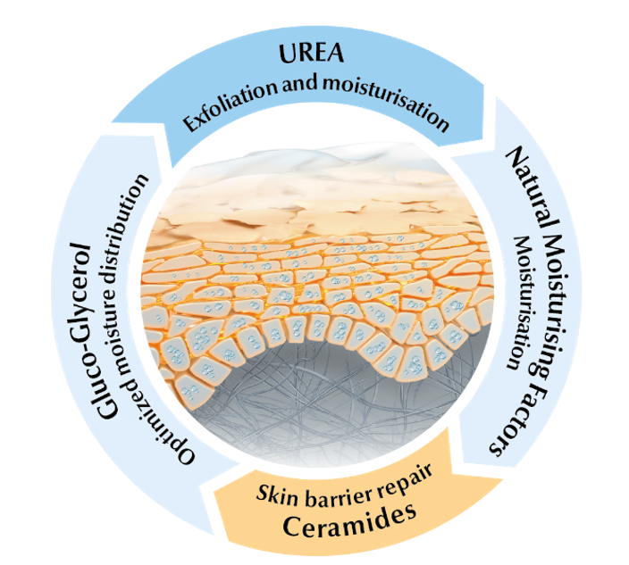
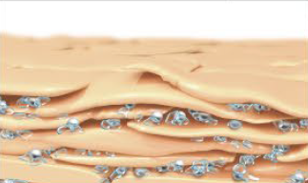
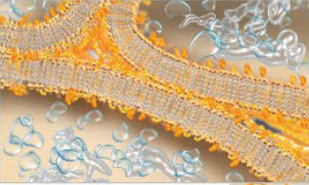
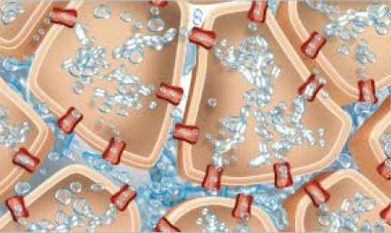
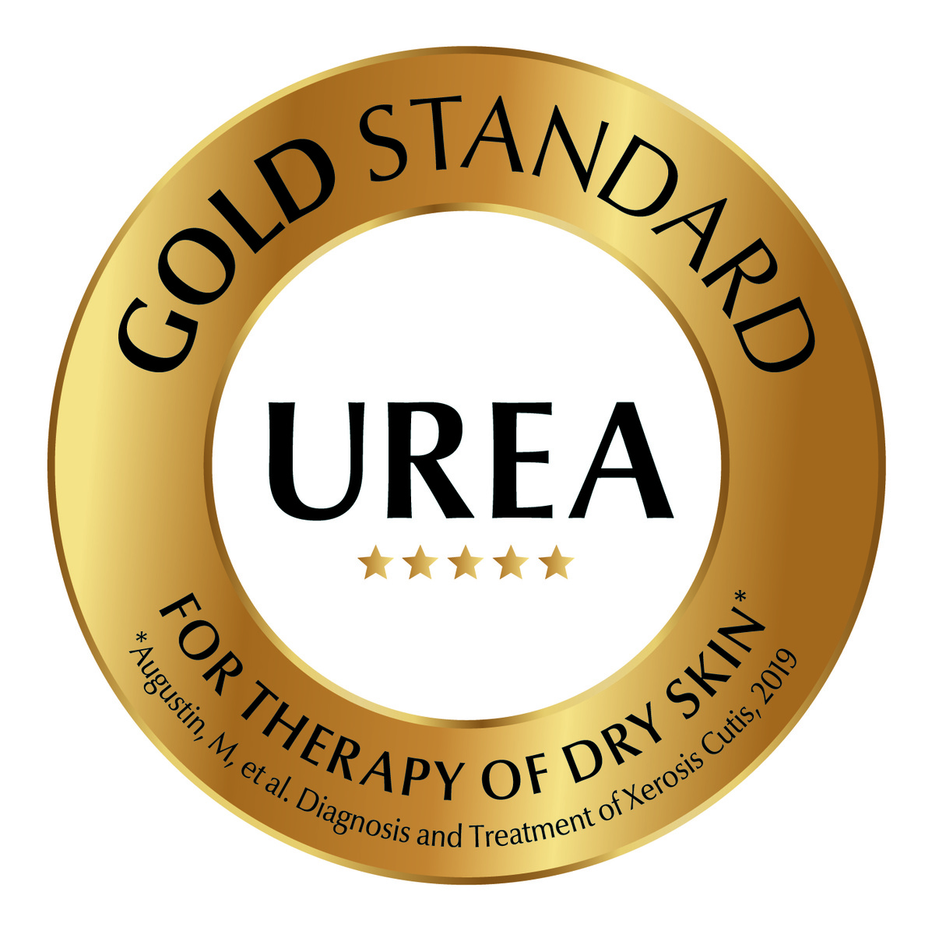
Dry, itchy and flakey Skin
UreaRepair PLUS – Most Important Ingredients
UREA + NMF´s
Skin-identical Urea and a unique NMF’s complex bind water in the upper epidermal layers
Ceramides
Skin-identical Ceramides form a protective lipid envelope and enhance the barrier function of the stratum corneum
Gluco Glycerol
fortifies the distribution of water in
deeper epidermal layers
Notes:
Explain the difference between the different Urea percentages and products.

Slide 24
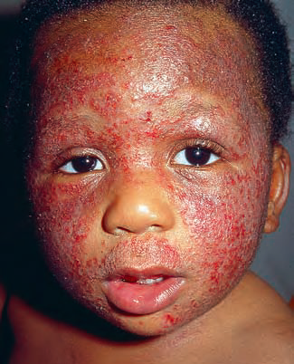
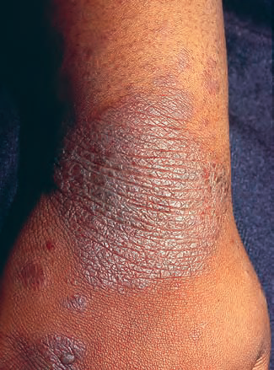
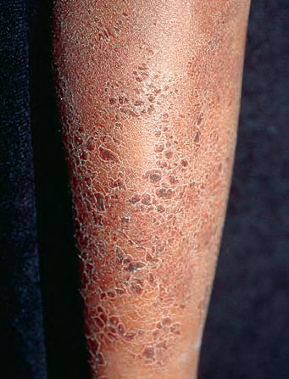
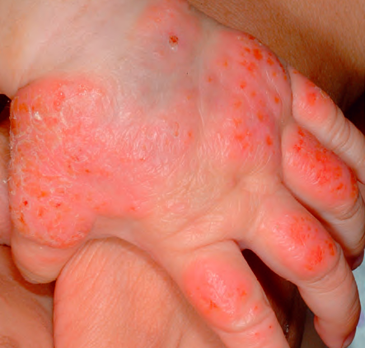
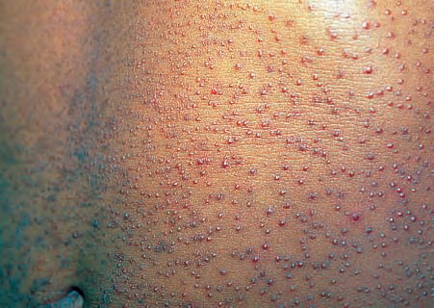
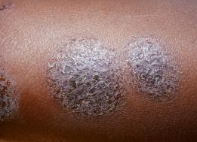
Different faces of eczema
Acute facial eczema
Lichen simplex chronicus
Eczema craquelle
Dyshidrotic eczema
Follicular eczema
Nummular eczema

Slide 25
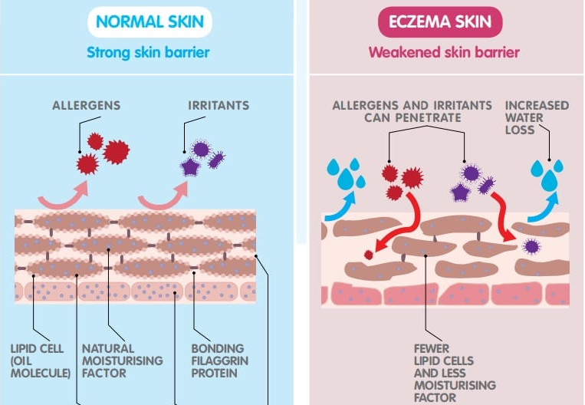
"brick and mortar" structure
genetic mutations with loss/decrease function of filaggrin protein

Slide 26
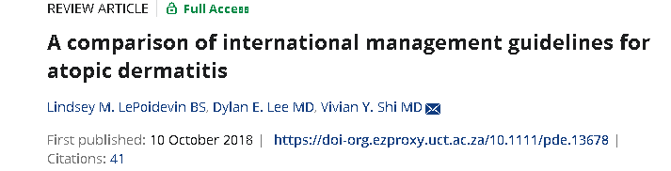
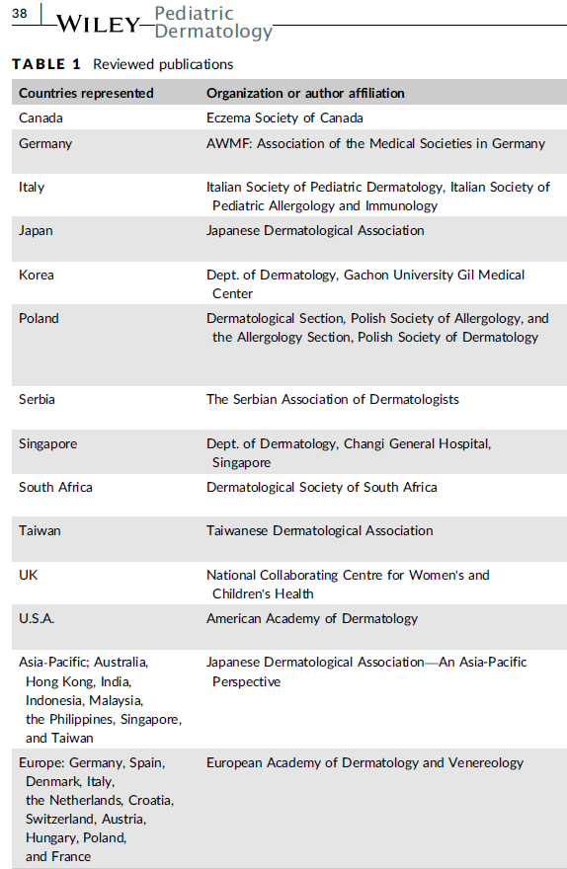
The purpose of this review was to compare international guidelines to highlight the similarities and variances among populations and skin types.
General measures
Limit environmental triggers (grass, pets, wool, detergents, chlorine)
Postbath moisturizer use, the so‐called soak-and-smear practice,
Moisturizing 2-4 times a day when skin feels dry
Soap substitute
1st line therapy
Topical corticosteroids - (FTU; approximately 0.5 g of topical agent) recommended across international societies
Mid‐to‐high‐potency TCS BD over short periods Max 2 weeks
Mid-Low potency TCS bd until rash clears
2nd line therapy
Tacrolimus (0,03%-0,1%) and Pimecrolimus, 1st line in areas prone to skin atrophy from TCS (peri-orbital, perioral, genital area)
Crisaborole, a phosphodiesterase 4 (PDE-4) inhibitor indicated for topical treatment of mild to moderate AD in children 3 months of age and older
Notes:
Avoidance of occlusive bandages due
to the increased rate of absorption and risk of nephrotoxicity is
ubiquitously agreed upon by all guidelines
26

Slide 27
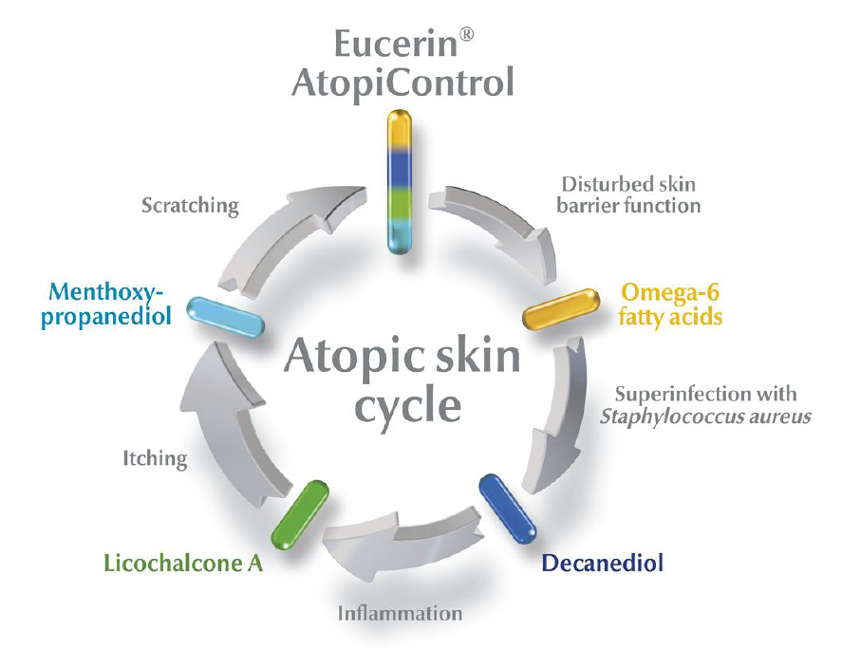
Eczema prone – Red, itchy and flakey skin
AtoControl – Tailor Made Solution for Atopic Skin
Notes:
The symptoms of Atopic Dermatitis are also the triggers. Because skin is dry and itchy, sufferers scratch. This scratching damages skin’s protective barrier and a bacteria known as Staphylococcus Aureus is able to multiply and infect skin. This infection causes inflammation and itching which worsens the condition making skin even more irritable and itchy: a vicious circle known as the Atopic Skin Cycle.

Slide 28

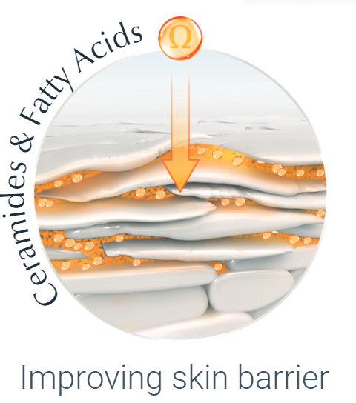
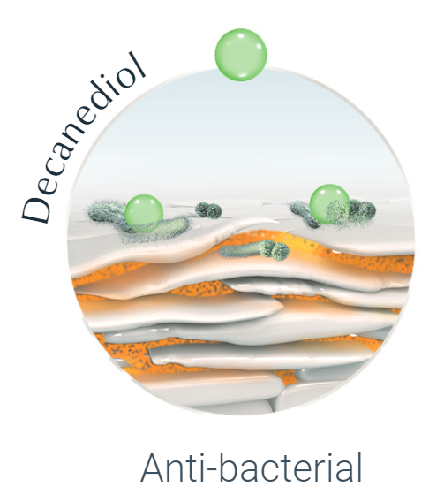
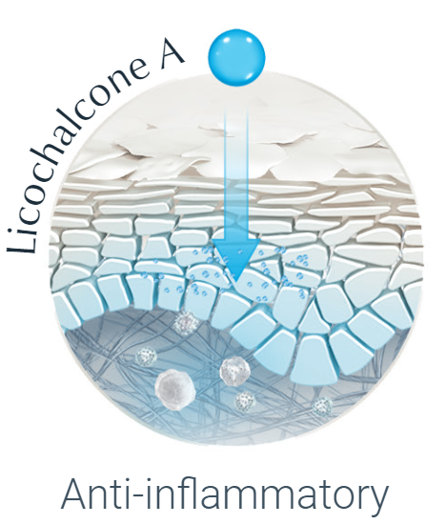
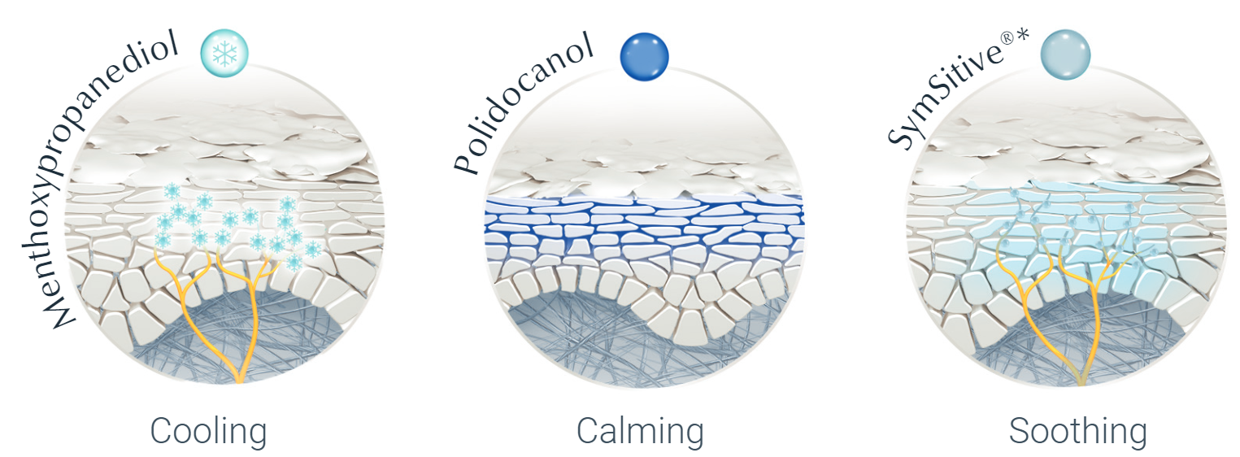
Eczema prone – Red, itchy and flakey skin
Factors and Key Active Ingredients
01 IMPAIRED BARRIER FUNCTION
02 BACTERIAL COLONISATION
(STAPH.AUREUS)
03 INFLAMATION
04 ITCHINESS
* registered trademark of Symrise Germany
Notes:
Evening Primrose Oil
A natural plant oil that contains a high percentage of Omega-6 fatty acids. These help stabilise the skin’s natural protective barrier and reduce moisture loss.
Grape Seed Oil
A rich source of essential fatty acids and Vitamin E.
A strong anti-oxidant which provide protection from damage.
Ceramides
strengthen the skin barrier, helping to prevent moisture loss
Decanediol
Has anti-bacterial properties. It is known to fight bacteria such as Staphylococcus aureus
Licochalcone A
A is a powerful antioxidant, anti-inflammatory and skin-soothing ingredient.
Menthoxypropanediol
Works at a sensory level to reduce feelings of itchiness.
Polidocanol
An antipruritic agent proven to soothe skin and help reduce itching.

Slide 29

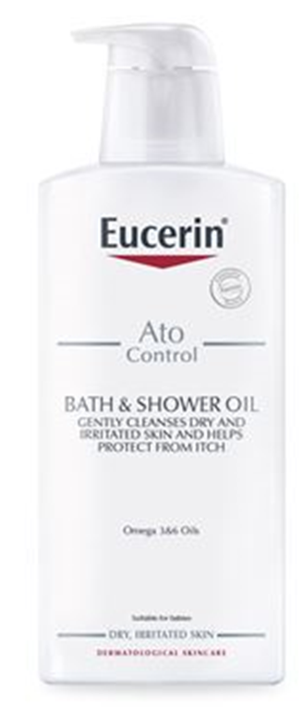
Atopic/Eczema Prone Skin
AtoControl Bath & Shower Oil
Suitable for newborns
moisturises
Barrier replenishment
GLYCINE SOJA OIL
Emulsifies water and binds moisture in the outermost layer of the skin
OMEGA 3 + 6
Replenishes the skin’s barrier, prevents moisture loss and keeps out irritants
PATIENT BENEFITS
Gentle daily cleanser for Atopic Prone Skin
Can be used during flare-ups and inactive phases
Fragrance-free, colourant-free and preservative-free

Slide 30
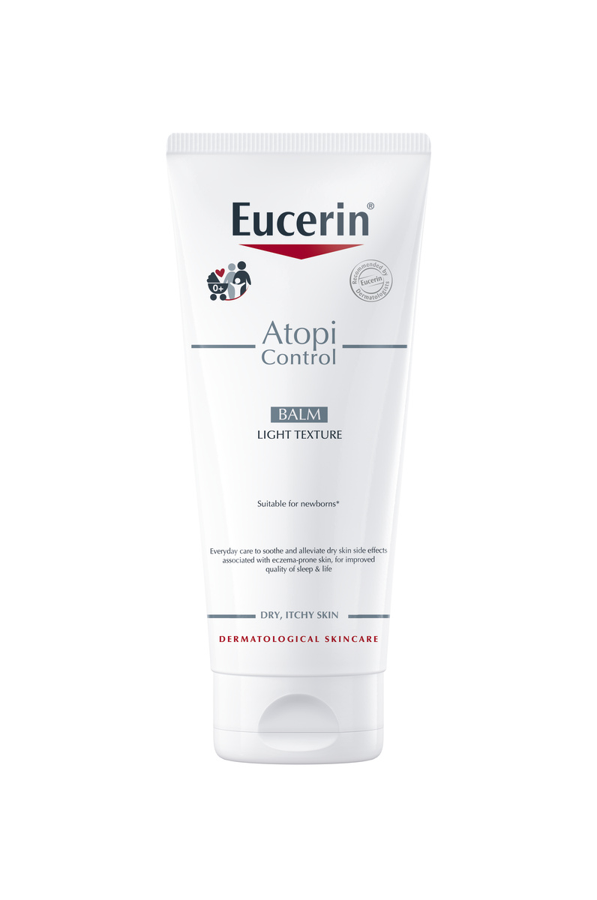
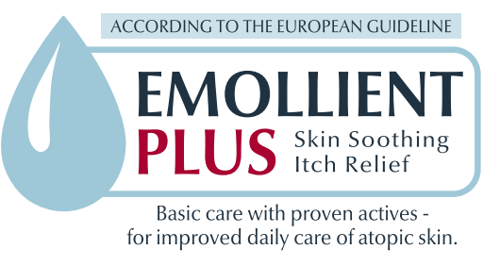
Atopic/Eczema Prone Skin
AtoControl Balm
Suitable for newborns
Anti-inflammatory
MOISTURISING
LICOCHALCONE A
Sooths red and inflamed skin and reduces itchiness
NMF’s + GLYCERINE
Prevent moisture loss
PATIENT BENEFITS
Fast Absorbing
Soothes itchy skin and prolongs the period between flare-up
For better quality of sleep and life
Fragrance-free
BARRIER PROTECTION
OMEGA 3, 6 + CERAMIDES + SHEABUTTER

Slide 31
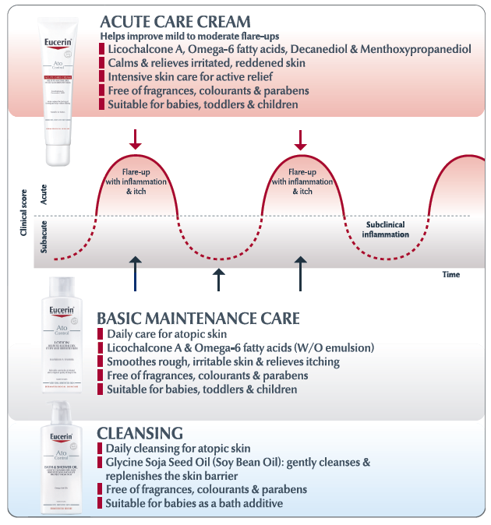

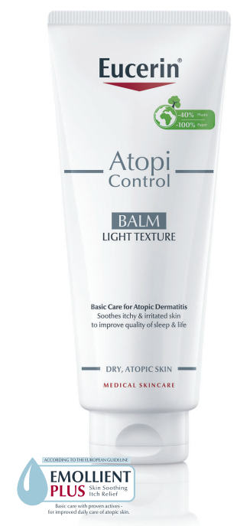
Different Stages of Atopic Dermatitis
Suitable for use from one month of age
Suitable for use from one month of age
Suitable for newborns
Suitable for newborns
Notes:
What is a flare-up?
Atopic Dermatitis has two distinct phases. A flare-up is one of the terms used to describe the phase when skin is at its most irritable.
A flare-up is also known as the ‘active phase’ or `acute phase` of the disease and symptoms include the following:
Itchy or intensely itchy skin. It may be sore too, and some people experience a burning sensation.
A rash that appears dry, red and flaky. It can be uneven or swollen and may bleed mildly.
Skin can flare up on any part of your body but the rash is most common on the face, scalp, neck, décolleté/chest, hands, wrists, the knee cavities and elbow folds. You can read more in Facial Atopic Dermatitis, Atopic Dermatitis on the head and scalp, Atopic Dermatitis on the hands and Atopic Dermatitis on different parts of the body. Symptoms also vary according to age and you can discover how in Atopic Dermatitis in babies and children and Adult Atopic Dermatitis.

Slide 32
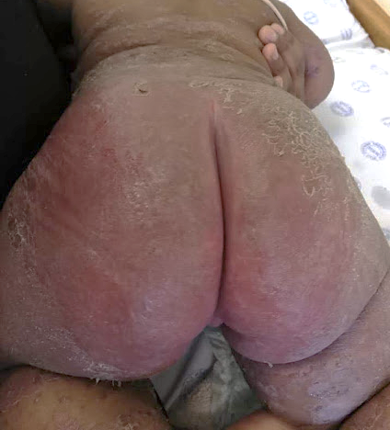
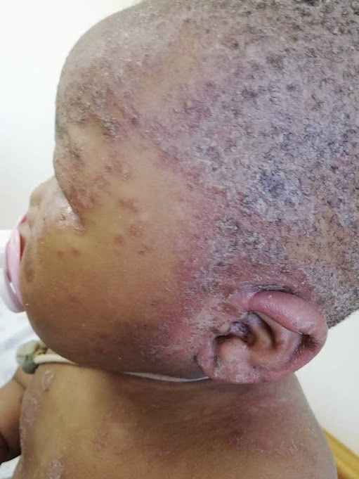
Seborrheic dermatitis
Type of eczema with characterized by:
  greasy scale, erythema, fissuring, occasional weeping
Predilection for ‘seborrheic’ areas rich in sebaceous glands.
Malassezia species (fungi) normal component of the skin microbiome may trigger seborrheic dermatitis
Presents in infants with a scaly dermatitis of the scalp termed “cradle-cap” (may spread over onto the face)
TREATMENT
Scalp: Coal Tar shampoo, selenium sulphide shampoo, imidazole shampoo
        Group 2-3 topical cortisone lotion, gel or ointment
Face: 1% hydrocortisone weak → moderate topical cortisone cream
Body: Group 2-3 topical cortisone cream
Barrier cream: zinc & castor oil (barrier cream), Vaseline, Aquaphor

Slide 33



Dry, Cracked Irritated Skin
Science Behind Aquaphor
Protection & regeneration
Protection from external irritants
Semi-occlusive barrier allows the transfer of water vapor and oxygen
Formulated for accelerate regeneration:
  Moisturizing properties (Glycerin and Panthenol)
  Regeneration and soothing ingredients (Panthenol and Bisabolol)
  Restores barrier with essential lipids (Lanolin alcohol)
Notes:
DRY, CRACKED SKIN occurs when the upper epidermis layer protective properties are compromised causing an increased moisture loss. An optimal moisture content of the skin is needed to promote the skin's natural regeneration processes.
SOS SKINCARE: CLINICALLY PROVEN TO REPAIR AND CARE FOR DRY, CRACKED, DAMAGED OR IRRITATED SKIN
DISCOVER MORE ABOUT THE FORMULA
The 7-ingredient formula, Eucerin Aquaphor, is gentle, non-comedogenic and accelerates skin regeneration. It doesn’t contain antibacterial agents, preservatives and fragrances.
Ingredients: Paraffinum Liquidum, Cera Microcristallina, Ceresin, Lanolin Alcohol (Eucerit®), Panthenol, Glycerin, Bisabolol.
The Paraffinium Liquidum (Liquid Paraffin) and Cera Microcristallina (a light and flexible wax) in the transparent, water-free ointment make it easy to apply gently to problem areas of skin. The formula forms a protective but semi-occlusive barrier over the skin that supports the natural transfer of water vapor and oxygen to and from skin, allowing skin to ‘breathe’ and strengthen its natural barrier function. Additionally, the Panthenol in the formula helps accelerate skin regeneration and Glycerin has moisturizing properties that attracts water and helps maintain it in the skin.

Slide 34


Eczema prone – Red, itchy and flakey skin
Balm or Lotion
ATOCONTROL BALM
O/W Emulsion for dry atopic skin
Light, fast absorbing daily care for itchy & irritated
With Licochalcone A, & Ceramides & Sheabutter
ATOCONTROL LOTION
W/O Emulsion for very dry, atopic skin
Rich daily care for itchy & irritated skin
With Licochalcone A, Ceramides & Omega Oils
Notes:
Explain the difference between the AtopiControl Lotion and the Balm
Participants should be able to test.
Key message: Lotion is not always appreciated due to greasiness and smell.
Balm formula indeed offers alternative values in regards to texture, greasiness and smell.
The Balm is oil “trapped” in water and the lotion is the other way round (water “trapped” in oil) –> explains differences in textures

Slide 35


PSORIASIS
Psoriasis is an immune-mediated polygenic skin disorder. Various environmental triggering factors, e.g. trauma, infections, and medications, may elicit disease in predisposed individuals. Psoriasis is potentially multisystem disease featuring extracutaneous manifestations in a subset of patients
sharply demarcated erythematous plaque with thick scale, plaques may be localized or widespread
Notes:
Need to exam the patient for joint involvement

Slide 36
TREATMENT GUIDELINES
 | MILD <3% BSA is mild | MODERATE 3% to 10% BSA is moderate | SEVERE >10% BSA is severe disease
1st line | Salicylic acid 2% + coal tar in white soft paraffin to remove scale 5% LPC (mane) Emollients | Same as for mild | Anthralin (Dithranol) Short contact or Long contact
2nd line | Vit D analogues + betamethasone 0.1% (Dovobet) Groups 3- 4 topical steroid | Anthralin (Dithranol) Phototherapy & combination of UV light and anthralin (Ingram regimen) | Phototherapy & combination of UV light and anthralin (Ingram regimen)
 | Calcineurin inhibitor (Protopic 0.03%, 0.1%) | Phototherapy Narrowband – UVB Acitretin plus NB-UVB combination therapy | Systemic Rx: Methotrexate Acitretin (pustular variant) Cyclosporine Biologics: Etanercept, Adalimumab, Infliximab Ustekinumab (IL-12/IL23)
Erythrodermic Psoriasis | Topical steroids - (Group 4) Cyclosporine - recommended for short-term crisis management of severe or unstable plaque, erythrodermic, or pustular psoriasis |  | Etanercept & Ustekinumab, FDA approved for patients with psoriasis 4 years and older and 12 years and older, respectively
Pustular psoriasis | Cyclosporine, Acitretin |  | The major risk for biologics in children is injection site reaction, but patients should be monitored for their increased risk of infection.
Psoriatic Arthritis | Methotrexate NSAIDS (rheum referral)
.
Notes:
the goal with all systemic therapies used in children - control or clear the disease, maintain stability for several months, and then taper to the lowest effective dose and, ultimately, transition off
systemic therapies if possible

Slide 37

Dry, itchy and flakey Skin
UreaRepair PLUS
Increase in Hydration
hydrates the skin
improves barrier function
improves the skin’s defense and hydration mechanisms
Aids penetration of active ingredients into the skin
antipruritic and keratolytic effects (>10%)
PSORIASIS
Notes:
Xerosis cutis is the medical term for abnormally dry skin. This name comes from the Greek word “xero,” which means dry. Dry skin is common, especially in older adults. It's usually a minor and temporary problem, but it may cause discomfort. Your skin needs moisture to stay smooth.
DEFINITION OF XEROSIS
Xerosis Cutis (synonym: dry skin, xerosis, xeroderma) is a skin condition poor
in hydrolipids, which is characterized by a reduced quantity and/or quality of
lipids and/or hydrophilic substances (the so-called Natural Moisturizing Factor).
FREQUENCY
Xerosis Cutis is one of the most frequent findings in dermatological and general
medical practice with an estimated prevalence of at least approx. 10 million
patients per year in Germany.
CAUSES OF XEROSIS
Xerosis Cutis is a disorder of the natural barrier function and/or a lack of moisturizing
factors of the skin, which lead to a reduced hydration of the skin.
Xerosis Cutis is basically a clinical diagnosis. Triggers and/or underlying diseases
must be identified and specifically treated. (100 % consensus)
Two key deficiencies in the skin have been shown to contribute to Xerosis:
A deficiency in skin barrier lipids
The cells in the horny layer are bound together by epidermal lipids. These lipids are essential for healthy skin: they create its protective barrier and bind in moisture. When lipids are missing, skin can become dry and may feel tight and rough.
A deficiency of Natural Moisturising Factors (NMFs)
Skin contains several other natural moisturising factors (NMFs) in addition to Urea. These are Lactate, PCA, salts and sugars. Like Urea, these NMFs attract moisture and bind it into the stratum corneum, or upper layer of the skin, preventing it from becoming dry, scaly and damaged.

Slide 38


Dry, itchy and flakey Skin
Gluco-Glycerol
Gluco-glycerol stimulates the creation of Aquaporin 3 (AQP3) in human skin cells,
Aquaporins control water transfer into and out of the cells.
↑ AQP3’s = better moisture distribution within the deeper layers of skin.
By stimulating skin’s own water system, Gluco-glycerol helps to moisturize skin and improve its barrier function
Dry skin
With Eucerin®
UreaRepair PLUS Lotion
Notes:
How Gluco-glycerol stimulates the Aquaporin network
Gluco-glycerol (also known as Glyceryl Glucoside) is a nature-identical combination of glycerol and glucose. Used by blue-green algae to ensure their survival for 3.5 billion years, Gluco-glycerol has been proven to stimulate the creation of Aquaporin 3 (AQP3) in human skin cells, thus increasing the number of aquaporins. Aquaporins control water transfer into and out of the cells. The more AQP3’s there are, the better the distribution of moisture within the deeper layers of skin.
By stimulating skin’s own water system, Gluco-glycerol helps to moisture skin and improve its barrier function.

Slide 39




Slide 40


7 year old boy presents with asymptomatic rash, started with the large plaque on the back then 1 week later rash spread to involve trunk & back

Slide 41


Pityriasis rosea
Pityriasis/pityron (Greek): “bran”, the flakes of skin shed resemble bran
Rosea (Latin): "rose-colored" or "pink."
Herald patch
Viral etiology suspected, but no single virus convincingly implicated.
Initial annular patch with collarette scale
Treatment
Resolves spontaneously over 6–12week
Symptomatic (emollients, mild topical steroids, antipruritics)
Notes:
Acute self-limited erythematous, squamous exanthem with classical clinical pattern.
After 1–2weeks, typical rash with fine scale, often arranged along skin folds creating Christmas tree pattern on back, Typically not found on face or distal extremities

Slide 42
Eczema prone – Red, itchy and flakey skin
Balm or Lotion
ATOCONTROL BALM
O/W Emulsion for dry atopic skin
Light, fast absorbing daily care for itchy & irritated
With Licochalcone A, & Ceramides & Sheabutter
ATOCONTROL LOTION
W/O Emulsion for very dry, atopic skin
Rich daily care for itchy & irritated skin
With Licochalcone A, Ceramides & Omega Oils
Notes:
Explain the difference between the AtopiControl Lotion and the Balm
Participants should be able to test.
Key message: Lotion is not always appreciated due to greasiness and smell.
Balm formula indeed offers alternative values in regards to texture, greasiness and smell.
The Balm is oil “trapped” in water and the lotion is the other way round (water “trapped” in oil) –> explains differences in textures

Slide 43


11 year old girl presents with 6 month history of severely itchy plaques on the dorsum of hands, arms and white lacey membrane on buccal mucosa. Also noticed change in her nails, become rough and painful.

Slide 44

Lichen planus
leichen (Greek): “tree moss” , planus (Latin): “flat”
Prototype of lichenoid dermatoses – idiopathic inflammatory disease of the skin & mucous membranes, thought to be T-cell-mediated autoimmune damage to basal keratinocytes that express altered self-antigens on their surface
5 P's:
  pruritic,
  purple,
  polygonal,
  plane topped
  papules
Wickham’s striae
Topical | Systemic (severe)
Super potent & potent corticosteroids | Short course prednisone
0.1% Tacrolimus | Narrowband UVB
Intralesional corticosteroids | Oral retinoids (acitretin)
Emollients | Cyclosporine

Slide 45
Eczema prone – Red, itchy and flakey skin
Balm or Lotion
ATOCONTROL BALM
O/W Emulsion for dry atopic skin
Light, fast absorbing daily care for itchy & irritated
With Licochalcone A, & Ceramides & Sheabutter
ATOCONTROL LOTION
W/O Emulsion for very dry, atopic skin
Rich daily care for itchy & irritated skin
With Licochalcone A, Ceramides & Omega Oils
Notes:
Explain the difference between the AtopiControl Lotion and the Balm
Participants should be able to test.
Key message: Lotion is not always appreciated due to greasiness and smell.
Balm formula indeed offers alternative values in regards to texture, greasiness and smell.
The Balm is oil “trapped” in water and the lotion is the other way round (water “trapped” in oil) –> explains differences in textures

Slide 46



Keratosis pilaris
Keratosis pilaris is a very common, dry skin condition caused by keratin accumulation in the hair follicles.
The Latin term keratosis means ‘scaly skin’ and pilaris means ‘hair’.
Keratosis pilaris usually starts in childhood but becomes more obvious during the teenage years and adulthood. It is harmless and is not infectious

Slide 48
Conclusion
Skin is the biggest organ in the body thus maintain its integrity and function is vital for survival and protection
Understanding the structure and function of the skin helps us to formulate and develop treatments and adjuvant treatments for all kinds of dry skin.
Selecting moisturizers (balm, lotion, oil, thick cream) should be driven by its active ingredient and the benefit of that ingredient to the skin and the condition that you want to treat
The best product should be effective, non-irritant and be affordable

Slide 49

How NOT to use your creams

Slide 50
References
Pamela Gallegos-Alcalá . 2021. The Keratinocyte as a Crucial Cell in the Predisposition, Onset, Progression, Therapy and Study of the Atopic Dermatitis. Int. J. Mol. Sci. 2021, 22, 10661. https://doi.org/10.3390/ijms221910661
Augustin, M., Berardesca, E., Blume-Peytavi, U., Elsner, P., Scafa, D., Schmeel, L. C., & Proksch, E. (2024). Managing dry skin in patients with comorbidities or with advanced age: unmet needs and roles for products containing potential emollient-plus ingredients. Journal of Dermatological Treatment, 35(1). https://doi.org/10.1080/09546634.2024.2326171
Bolognia, J., Schaffer, J. and Cerroni, L. (2017). Dermatology. 4th Edition. Elsevier - OHCE.
White-Chu, E Foy, and Madhuri Reddy. “Dry skin in the elderly: complexities of a common problem.” Clinics in dermatology vol. 29,1 (2011): 37-42. doi:10.1016/j.clindermatol.2010.07.005
L, Eichenfield. 2014. Guidelines of care for the management of atopic dermatitis. Journal of the American Academy of Dermatology, Volume 71, Issue 1, 116 – 132. DOI:https://doi.org/10.1016/j.jaad.2014.03.023

